Slide 1

Module 14: Migrating Applications to the AWS Cloud

Slide 2
Topics
Defining cloud strategies
Planning migrations
Deploying applications
Optimizing applications

Slide 3
Topics
Defining cloud strategies
Planning migrations
Deploying applications
Optimizing applications

Slide 4
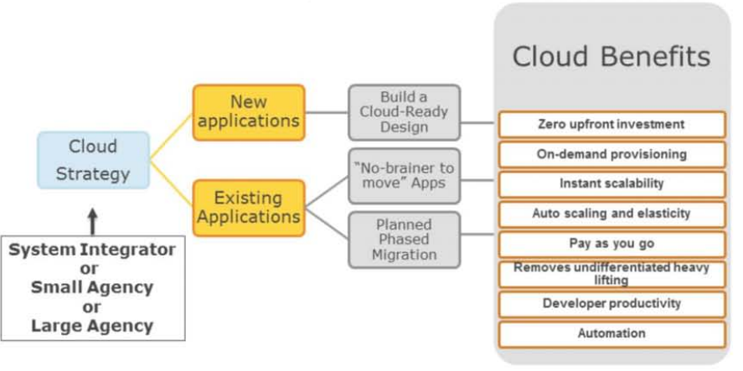
Building a Cloud Strategy

Slide 5
“No-brainer to move” Apps
Dev/Test applications
Self-contained Web applications
Social Media Product Marketing Campaigns
Customer Training Sites
Video Portals (Transcoding and Hosting)
Pre-sales Demo Portal
Software Downloads
Trial Applications

Slide 6
Topics
Defining cloud strategies
Planning migrations
Deploying applications
Optimizing applications

Slide 7
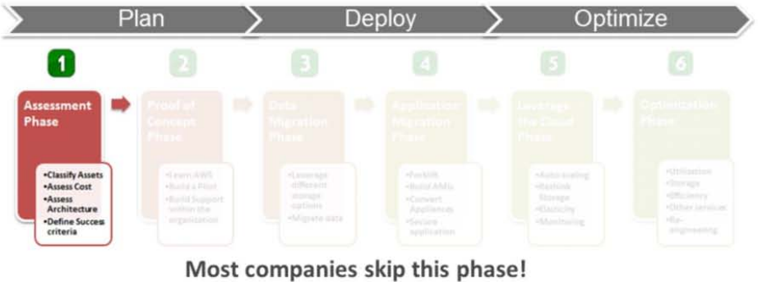
Phased Approach to Plan Migrations
Goal: Identify which application to move first

Slide 8
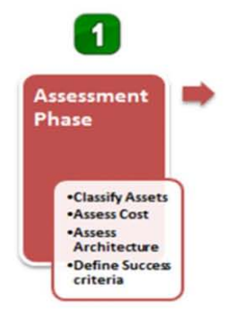
Planning Migrations: Assessment phase
Questions you need to ask:
Which business applications should move to the cloud first?
Does the cloud provide all of the infrastructure building blocks you require?
Can you reuse your existing resource management and configuration tools?
What are my legal, governance and compliance requirements?
What are your criteria to measure success? How will you measure it?

Slide 9
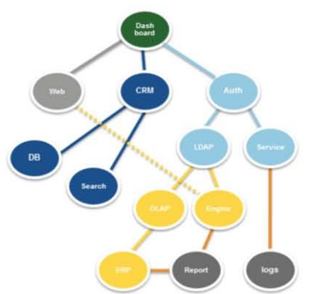
Classifying your IT Assets
List all your IT assets
Identify upward and downward dependencies
Start classifying your IT assets into different categories:
Applications with Classified, Sensitive, or Public data sets
Applications with low, medium and high compliance requirements
Applications that are internal-only, partner-only or customer-facing
Applications with low, medium and high coupling
Applications with strict, relaxed licensing

Slide 10
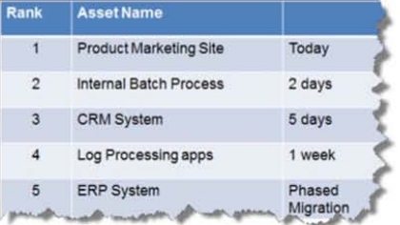
Stack rank your IT assets; select the low-hanging fruits first
Search for under-utilized IT assets
Applications that have immediate business need to scale
Applications that are running out of capacity
Easiest to move today
That builds support within your organization and creates awareness and excitement

Slide 11
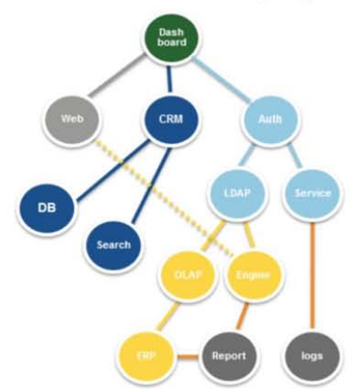
Pick the Low-hanging fruit
Example
Web Applications
Batch Processing systems
Content Management Systems
Digital Asset Management Systems
Log Processing systems
Collaborative Tools
Big Data Analytics Platforms

Slide 12
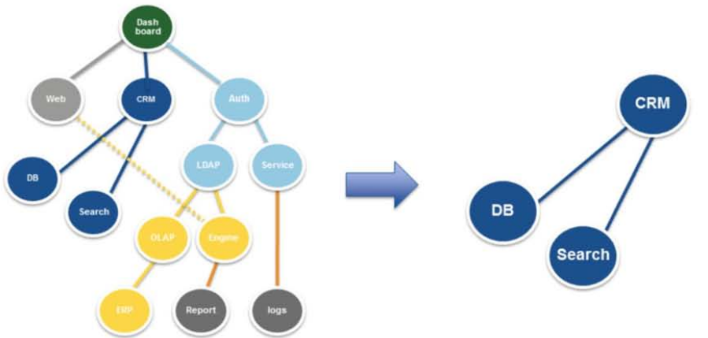
Move Application by Application

Slide 13
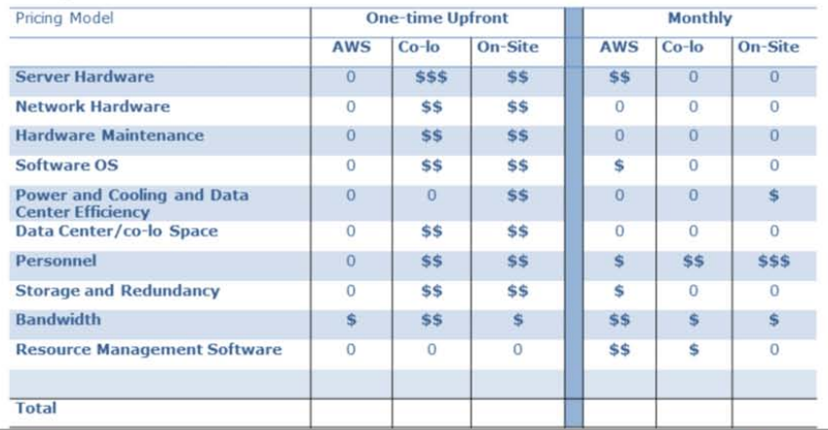
Manage Costs

Slide 14
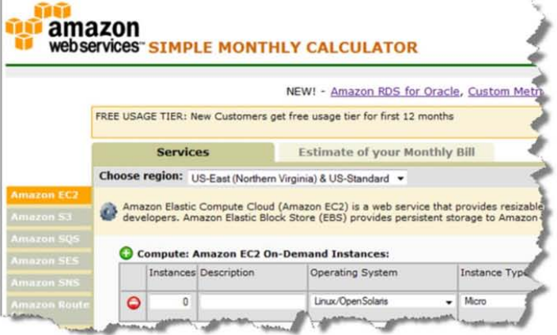
Cost to run in AWS?

Slide 15

Flexible Licensing Options Available Today
Bring Your Own License(BYOL)
Use a utility style pricing model with a support package
Use ISV Cloud Service

Slide 16
Define your Success Criteria
Developer Productivity
Business Agility
Reduced Time to Market
Data center efficiency
Redundancy
Chargeback and Billing
Eliminates “Heavy lifting”
Foundation of 21st century architectures
Reduced waste/recycle
Hardware upgrades
Less number of 24/7 Personnel
Cloud is no just about saving money

Slide 17
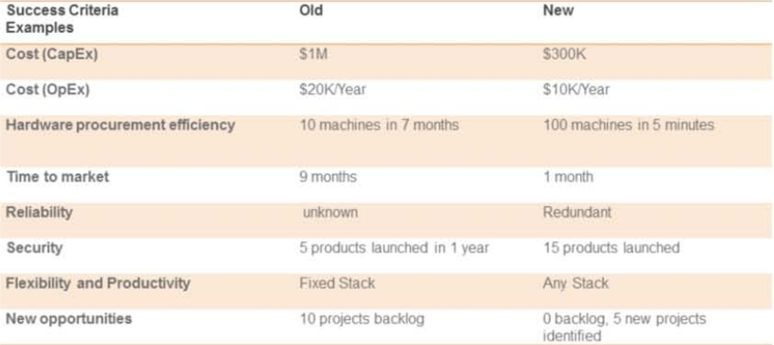
Define your Success Criteria and measure it

Slide 18
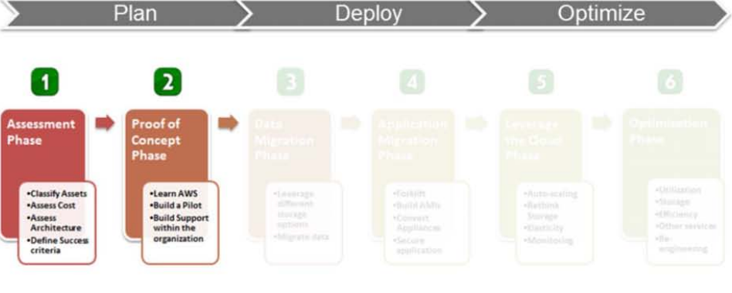
Planning Migrations

Slide 19
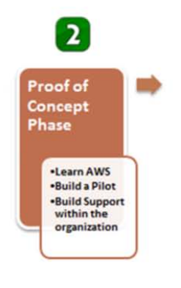
Planning Migrations: Proof of Concept
Questions you need to ask:
Will I learn different aspects of the AWS cloud by building this proof of concept?
How much effort is required to port a small dataset and small app?
Will this proof of concept build support and create awareness within the organization?
What is the best way to capture all my lessons learned? A whitepaper?
Which applications can I move immediately after this proof of concept?

Slide 20
Invest in Proof of Concept Early
Get your feet wet with Amazon Web Services
Learning AWS
Build reference architecture
Be aware of the security features
Build a Prototype/Pilot
Build support in your organization
Validate the technology
Test legacy software in the cloud
Perform benchmarks and set expectations
Proof of concept will answer tons of questions quickly

Slide 21
Topics
Defining cloud strategies
Planning migrations
Deploying applications
Optimizing applications

Slide 22
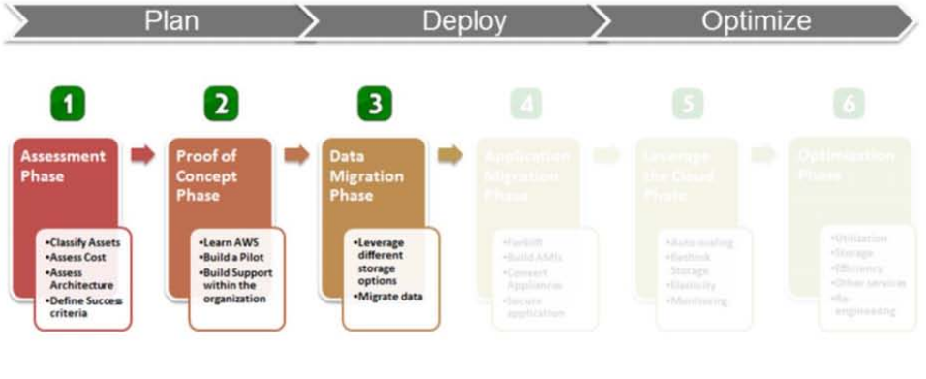
Planning Migrations: Deploy

Slide 23
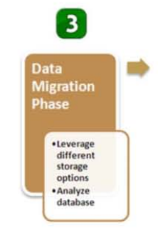
Planning Migrations: Deploy Applications
Includes:
Learning about different database storage options available today
Upload/Moving your data in Batches
Analyzing your database/datasets
Build necessary tools and scripts to migrate data
Security of your data (Encryption)

Slide 24
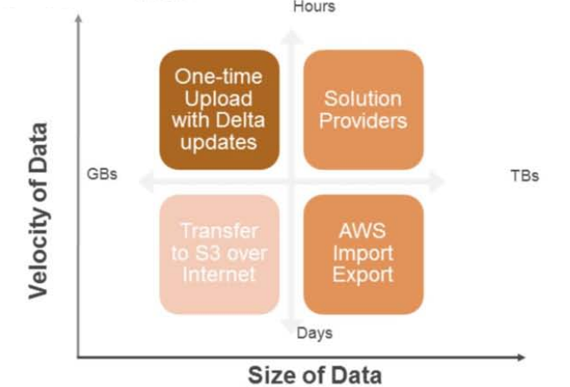
Deploy Applications

Slide 25
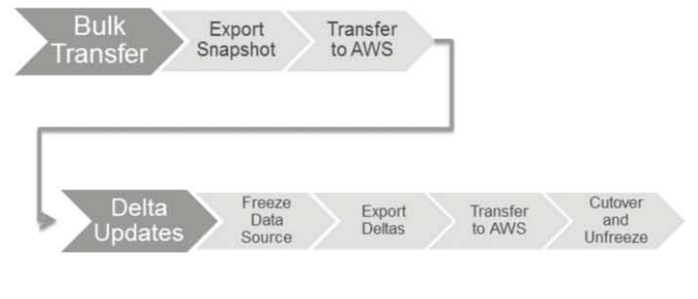
Deploying Applications
Cutting Over Your Master Data Store

Slide 26
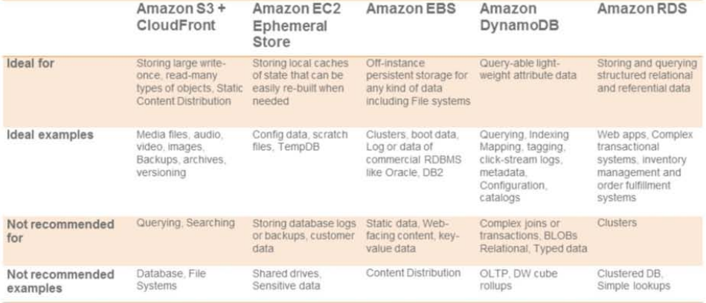
Deploying Applications

Slide 27
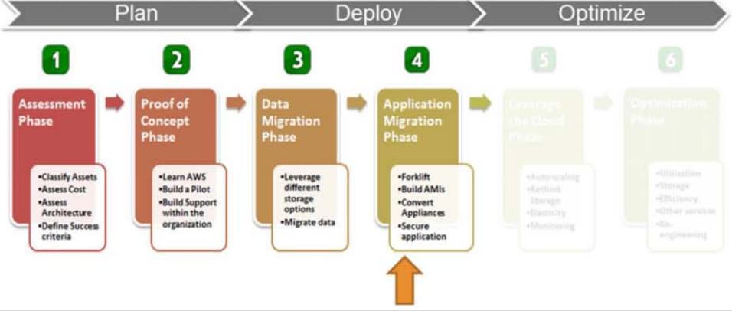
Planning Migrations: Application Migration

Slide 28
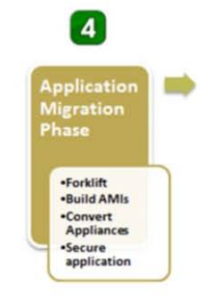
Planning Migrations: Application Migration
Includes-Forklift:
Match your HW resources to the cloud
Build AMIs
Convert to virtual appliances
Deploy supporting components(SAN, NAS, Domain controllers…..)
Secure your application
Reuse existing management and monitoring tools or use cloud tools

Slide 29
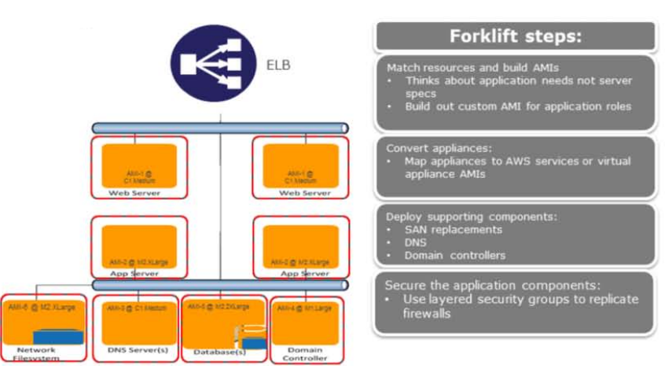
Forklift Steps

Slide 30
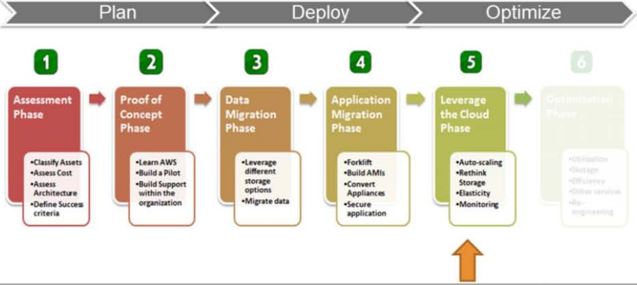
Planning Migrations: Leveraging the Cloud

Slide 31
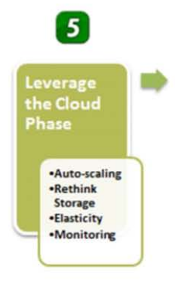
Planning Migrations: Leveraging the Cloud
Embrace and Implement Elasticity
Bootstrap AMIs
Automate processes
Leverage Auto Scaling
Leverage new storage options by AWS
Harden Security (IAM)

Slide 32
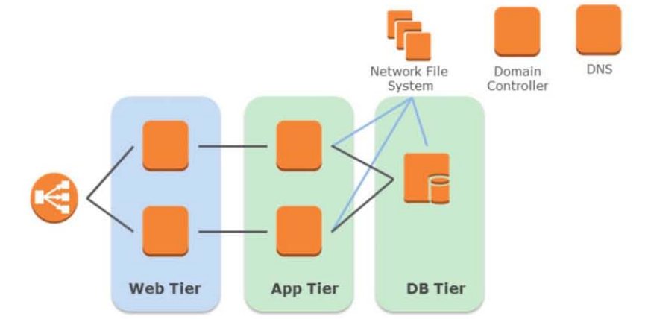
Planning Migrations: Leveraging the Cloud

Slide 33
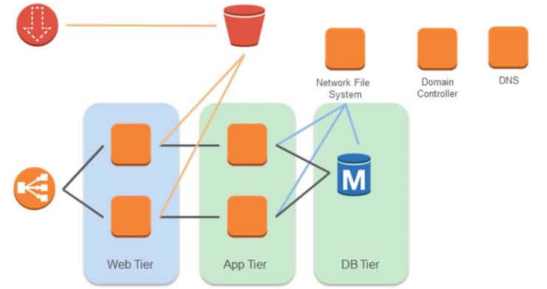
Planning Migrations: Leveraging the Cloud

Slide 34
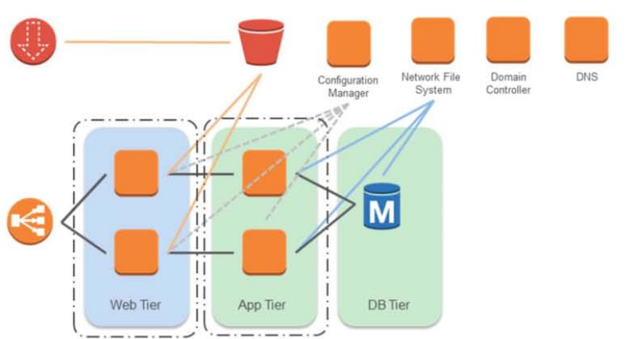
Planning Migrations: Leveraging the Cloud

Slide 35
Accelerate the cloud adoption within your organization
Be a Cloud Advocate
Starting a weekly sync meeting
Share Lessons Learned (Brownbags)
Document Best Practices
Reuse tools, scripts, How-Tos
Start Cloud Computing practices or Cloud Computing Center Of Excellence
Educate and Evangelize
Be the Cloud Champion within your company or team

Slide 36
Topics
Defining cloud strategies
Planning migrations
Deploying applications
Optimizing applications

Slide 37
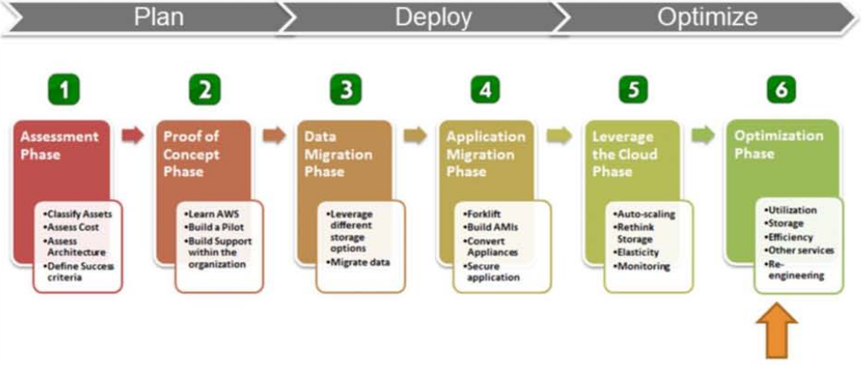
Planning Migrations: Optimize applications

Slide 38
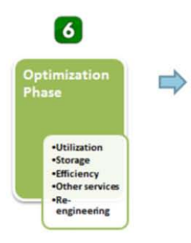
Planning Migrations: Optimize applications
Improve efficiency:
Re-rethink Storage
Parallel processing
Optimize for cost
Optimize for availability
Leverage scalable on-demand services like SNS, SQS

Slide 39
Optimize applications
Re-re-think storage
Break up datasets across storage solutions based on best fit and scalability
Parallelize processing
Spread loads across multiple resources
Decouple components for parallel processing
Use spot instances where possible to reduce costs
Embrace scalable, on-demand services
Scale out systems with minimal effort
Route 53
SES, SQS, SNS

Slide 40
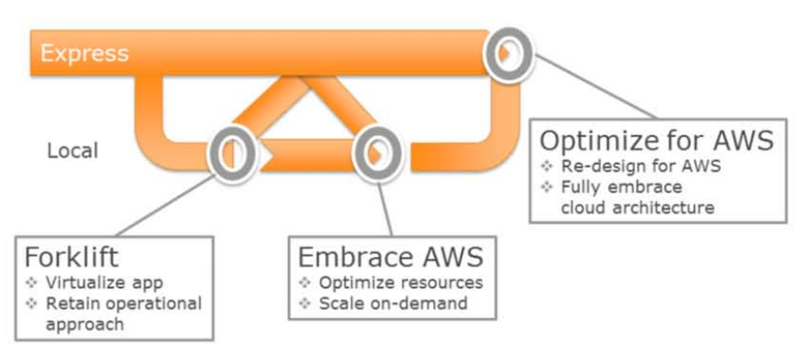
Finding your first stop………

Slide 41
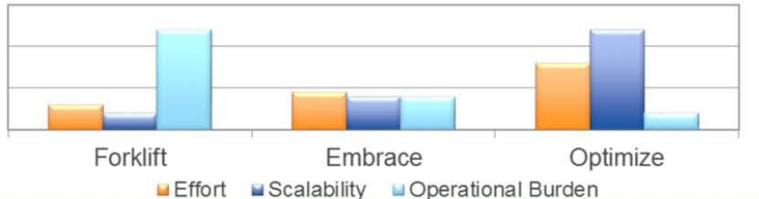
The Migration Continuum
Forklift | Embrace AWS | Optimize for AWS
May be only option for some apps Run AWS like a virtual co-lo Does not optimize for on-demand | Minor modifications to improve cloud usage Automating servers can lower operational burden Leveraging more scalable storage | Re-design with AWS in mind Embrace scalable services Closer to fully utilized resources at all times

Slide 42
Key Takeaways
Classify and stack rank your apps and move the easy ones first, gain confidence and define your success criteria
Dive into a Proof of Concept quickly as it will answer several questions quickly
Leverage multiple storage options-one size does not fill all
Migrate with confidence: Forklift-Leverage-Optimize
Be the Cloud Champion within your agency, department or team

Slide 43
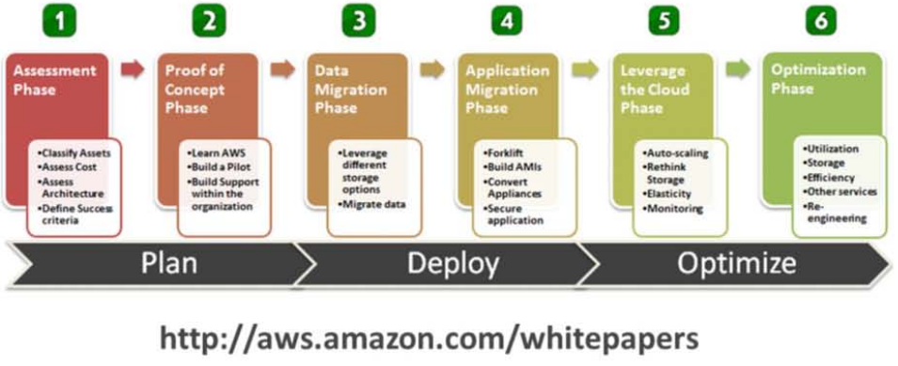
Cloud Migration: A phased approach

Slide 44
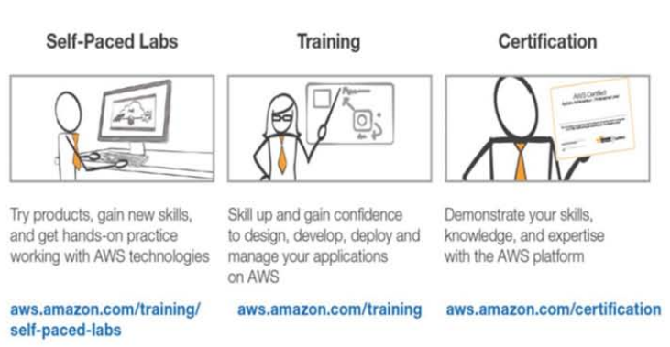
Get Training

Slide 45
